Slide 1
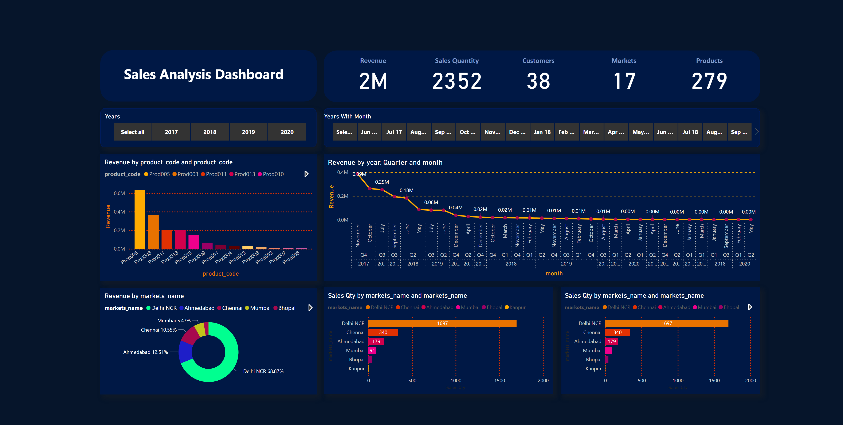
Page 1
Notes:
donutChart
No alt text provided
barChart
No alt text provided
barChart
No alt text provided
columnChart
No alt text provided
Revenue
No alt text provided
shape
No alt text provided
Sales Quantity
No alt text provided
Customers
No alt text provided
Markets
No alt text provided
Products
No alt text provided
lineChart
No alt text provided
Years
No alt text provided
Years With Month
No alt text provided
shape
No alt text provided
textbox
No alt text provided

